Slide 1
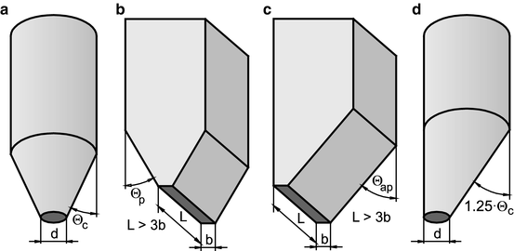
Hopper: Stress distribution & Designing
Powders and Bulk Solids. Behavior, Characterization, Storage and Flow. Authors: Schulze, Dietmar, Springer

Slide 2

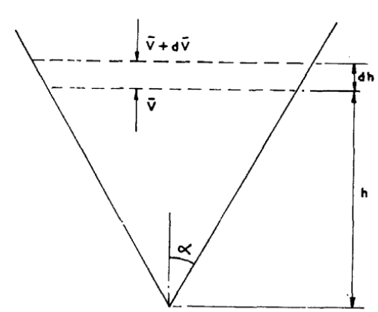












r
$φ_{e}$ : Angle of Internal Friction
$φ_{x}$ : Angle of Wall Friction
In a hopper, stress decreases as we towards mouth or exit.
In a hopper, near the mouth the vertical stress is proportional to local radius.

Slide 3
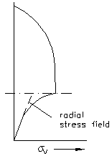
Stress profile
Powders and Bulk Solids. Behavior, Characterization, Storage and Flow. Authors: Schulze, Dietmar, Springer

Slide 4
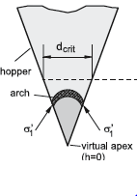
Critical Diameter to avoid Arching
In a hopper, as we go near mouth, the vertical stress decreases, whereas cohesive forces start dominating.
Hence arch formation usually takes place near the mouth of the hopper.
If the vertical stress is able to overcome the yield stress of Arch formed due to cohesive forces, no arch formation will take place.
There exists a critical diameter, above which no arch formation is possible.
Assumptions:
- plays a role in an indirect way.
Weight of material above arch is very small as compared the total weight of the material kept in cylindrical section.
The major normal stress experienced by arch is .
Powders and Bulk Solids. Behavior, Characterization, Storage and Flow. Authors: Schulze, Dietmar, Springer

Slide 5
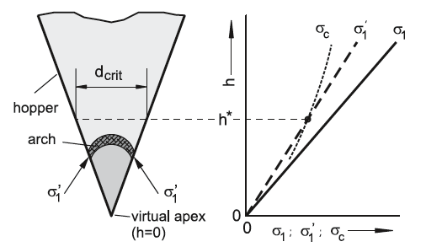
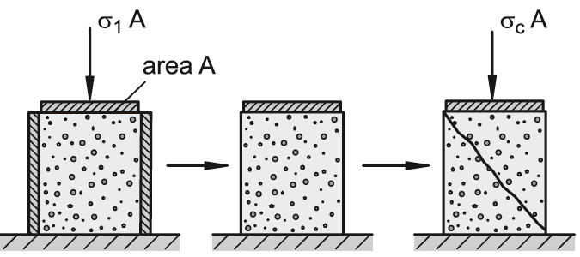
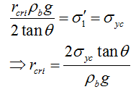
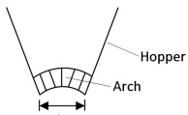







Critical Diameter to avoid Arching
Unconfined Yield Strength
$$dl$$
$$dz$$
Powders and Bulk Solids. Behavior, Characterization, Storage and Flow. Authors: Schulze, Dietmar, Springer

Slide 6
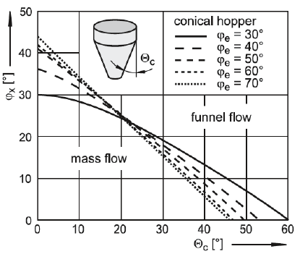
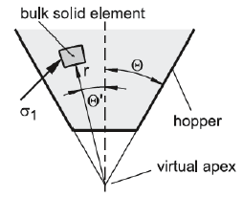


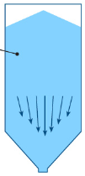


JENIKE’s Flow Phase diagram for a hopper
$φ_{e}$ : Angle of Internal Friction
$φ_{x}$ : Angle of Wall Friction
Powders and Bulk Solids. Behavior, Characterization, Storage and Flow. Authors: Schulze, Dietmar, Springer

